Slide 1
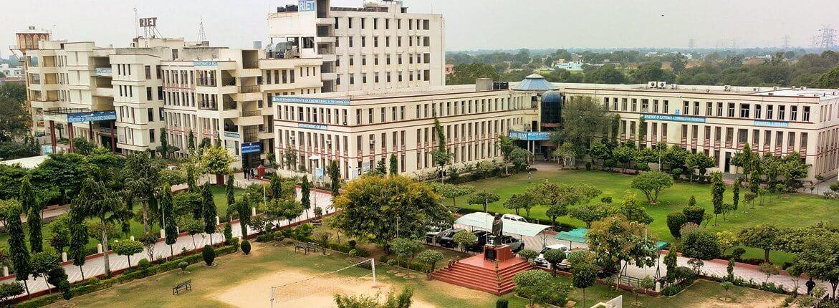
POORNIMA
HACKATHON 2021

Slide 2
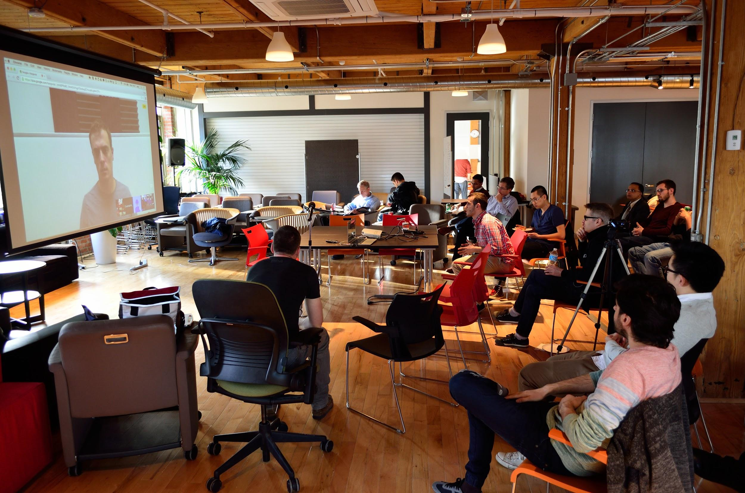
Team name : Technothorn
Project name : To create IoT based system for smart parking.

Slide 3
Contents
Objective
Introduction
Project Timeline
Stages of Development
Component description
Arduino Uno
NodeMCU
IR Sensor
Arduino IDE
Flowchart
Working
Advantages
Application
Conclusion

Slide 4
Objective
The main aim of this project is reduces the risk of finding the parking slots in any parking area.
It eliminates the unnecessary travelling of vehicles across the filled parking slots in a city.

Slide 5
Introduction
Smart Car Parking System is an integrated system to organize cars in public areas.
All vehicles enter into the parking and waste time for searching for parking slot .

Slide 6
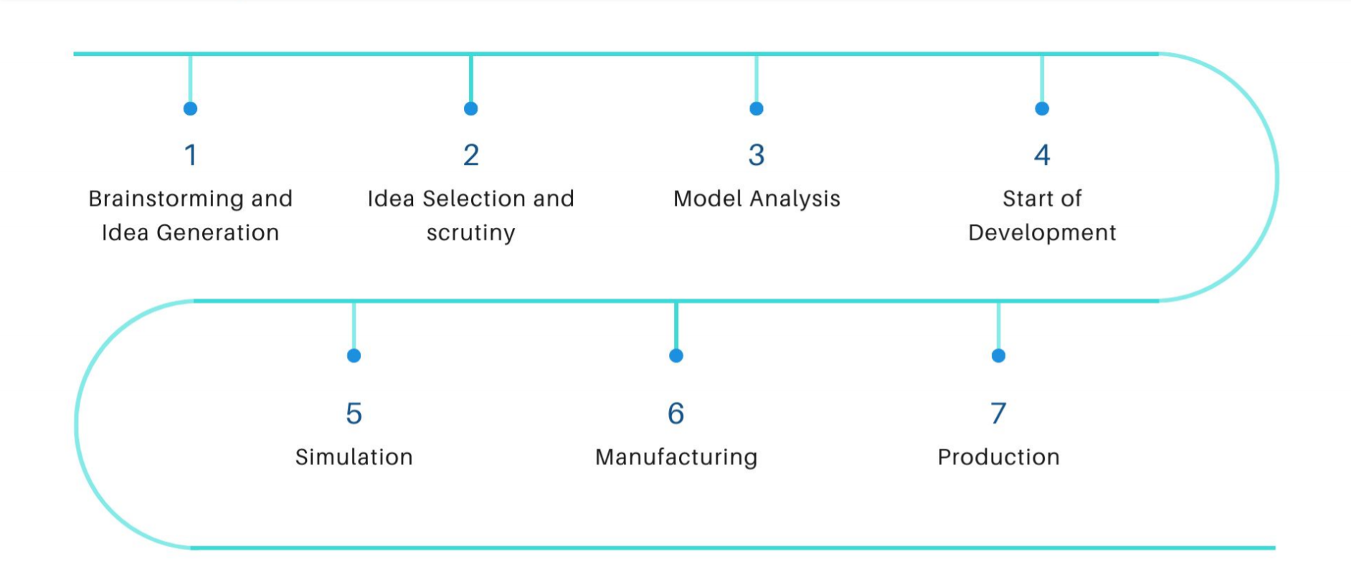
Project Timeline

Slide 7
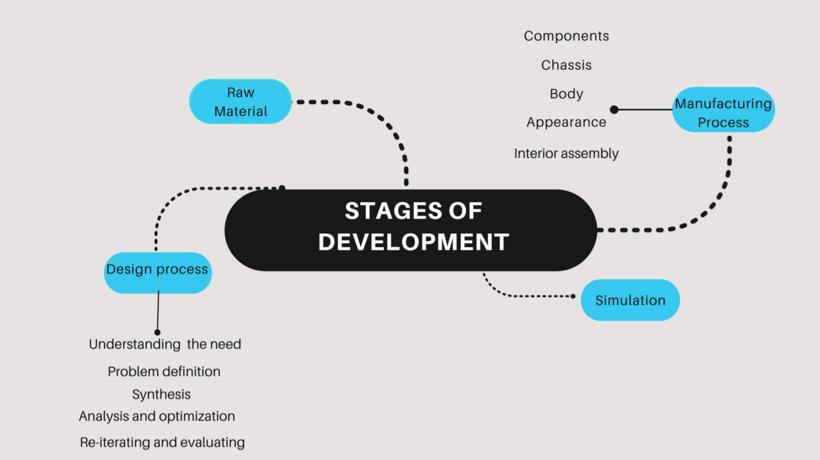

Slide 8
Component description
Hardware | Software
Nodemcu | Arduino IDE
ARDUINO UNO | Firebase
IR Sensors
Servo Motors

Slide 9
Arduino Uno
Microcontroller: ATmega328
Operating Voltage: 5V
Input Voltage (recommended): 7-12V
Input Voltage (limits): 6-20V
Digital I/O Pins: 14 (of which 6 provide PWM output)
Analog Input Pins: 6
DC Current per I/O Pin: 40 mA
DC Current for 3.3V Pin: 50 mA
Flash Memory: 32 KB
Clock Speed: 16 MHz

Slide 10
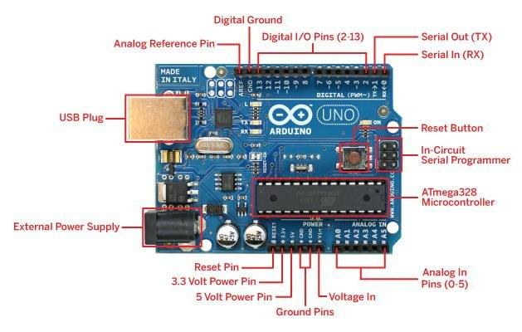

Slide 11
Node MCU
32-bit RISC CPU 80MHz
64KB of instruction RAM
4MB flash
96 KB of data RAM
13- GPIO pins
Can be programmed with C/C++, Python, Arduino IDE

Slide 12
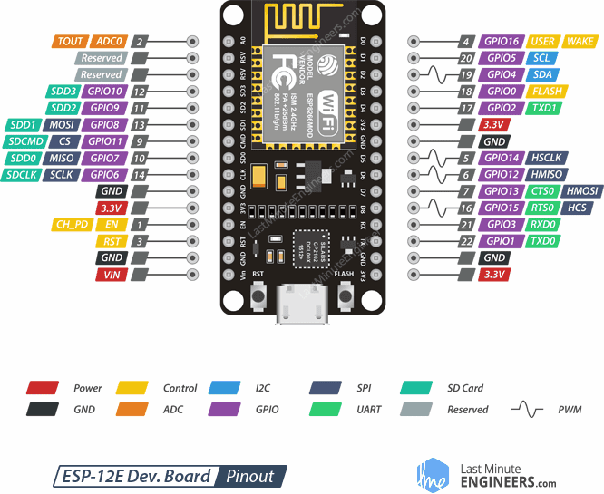
Node MCU

Slide 13
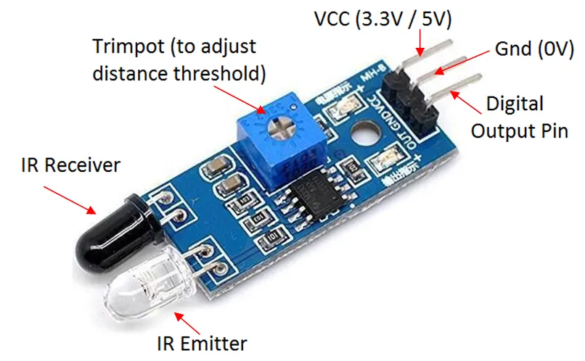
IR - Sensor
Active output level: Outputs Low logic level when obstacle is detected.
On board Obstacle Detection LED indicator

Slide 14
Arduino IDE
The Arduino IDE supports the languages C and C++ using special rules of code structuring.
The Arduino IDE supplies a software library from the Wiring project, which provides many common input and output procedures.

Slide 15
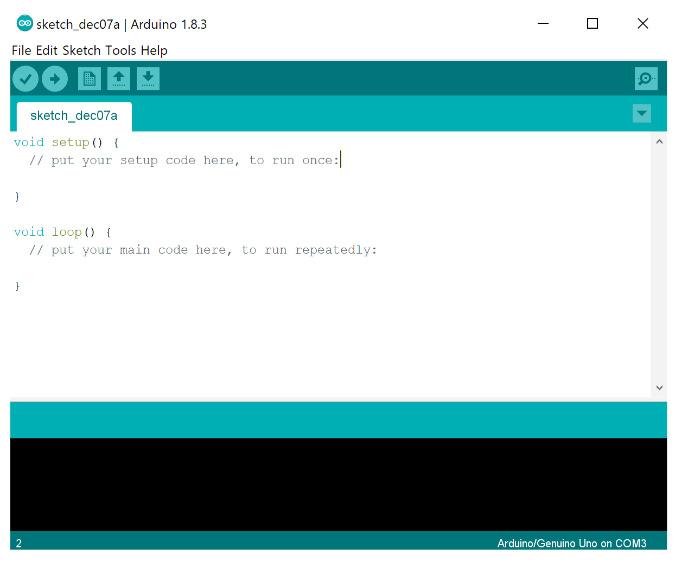
Arduino IDE

Slide 16
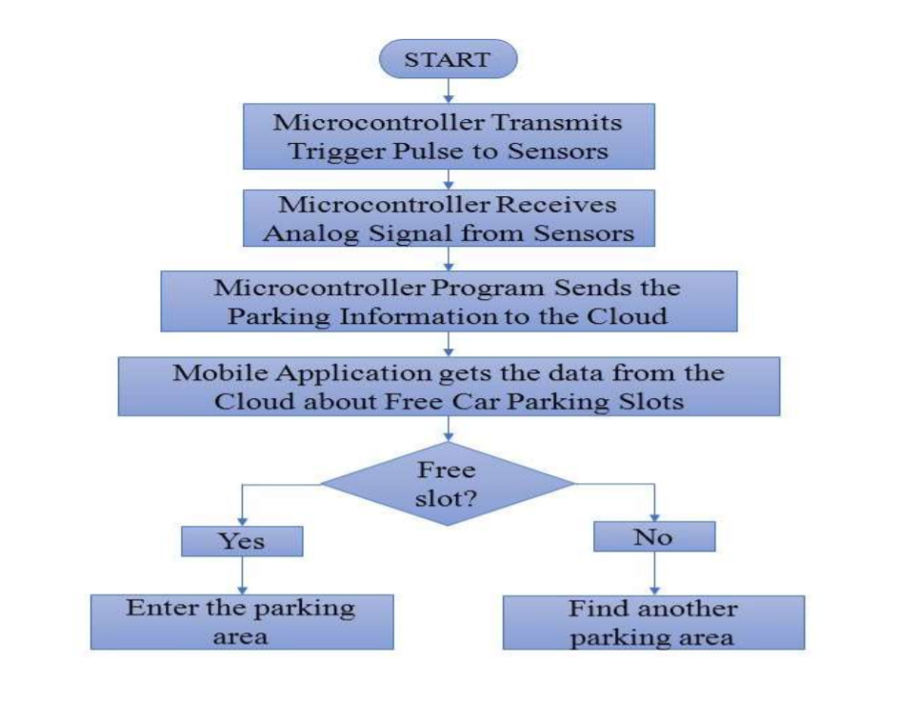
Flow Chart

Slide 17
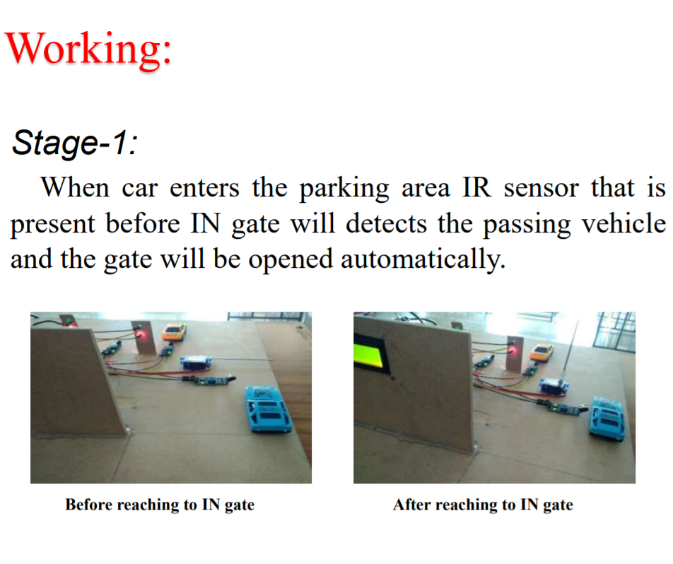

Slide 18
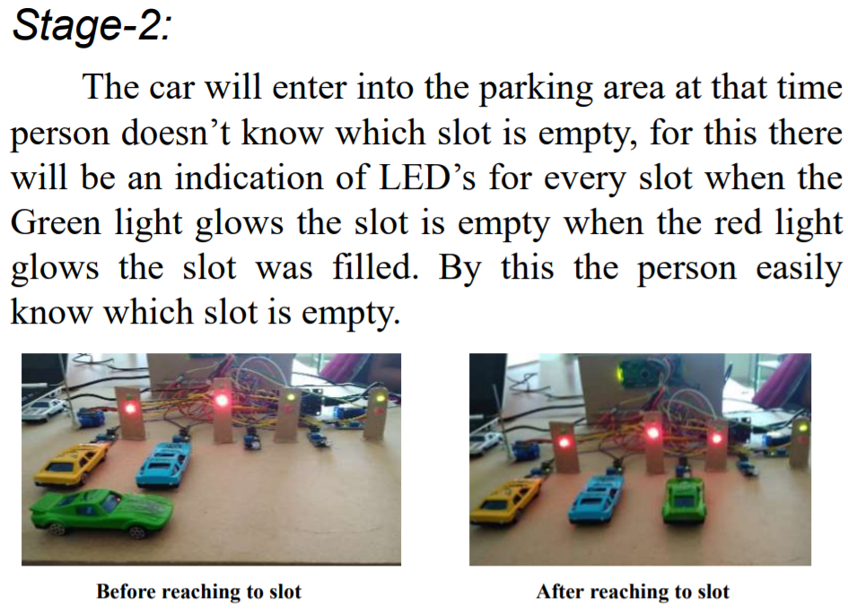

Slide 19
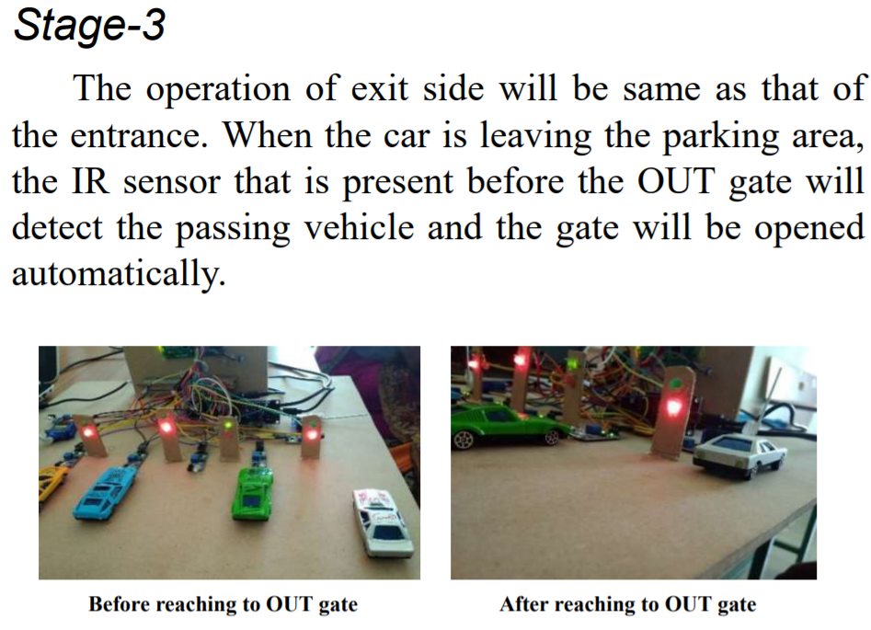

Slide 20
Advantages
Shorter waiting time at parking place.
It saves fuel, money, space and time.
Reduced pollution.
Reduced traffic.
Carbon emission is reduced.
Efficiency

Slide 21
Applications
The smart car parking system can be implemented in …
• Shopping malls
• Restaurants
• Theatres

Slide 22
Conclusion
This project focuses on implementation of car parking place detection using Internet of Things.
The system benefits of smart parking go well beyond avoiding time wasting.
Developing a smart parking solutions with in a city solves the pollution problem.

Slide 23


